Slide 1
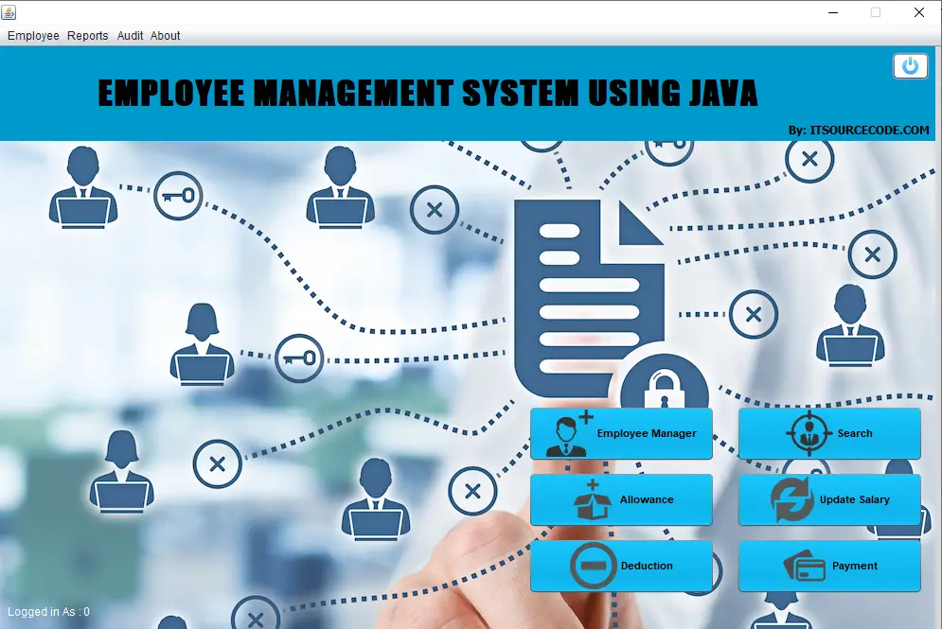
Department of Information Technology
Real Time Project
Employee Management System
Presented by:
Student Name : Allari Sirithreksha
B.TECH in Information Technology

Slide 2
Abstract
In today's dynamic work environment, effective employee management is essential for organizational success. This abstract introduces an Employee Management System (EMS) developed using widely accessible web technologies such as HTML, CSS, and JavaScript. The Employee Management System (EMS) provides a user-friendly interface accessible through web browsers, enabling seamless interaction for both employees and administrators. Administrators have the ability to manage employee information, track attendance, and generate insightful reports to streamline decision-making processes. By leveraging the power of HTML for structure, CSS for styling, and JavaScript for dynamic functionality, this Employee Management System (EMS) offers a scalable and adaptable solution for businesses of all sizes.
The Employee Management System (EMS) presented in this abstract is web technologies to revolutionize traditional methods of employee management, promoting efficiency, transparency, and collaboration within the workplace’s organizational success.

Slide 3
Introduction
An Employee Management System (EMS) is a crucial tool for businesses to efficiently handle their workforce. Using web technologies such as HTML, CSS, and JavaScript, we can create a user-friendly Employee Management System (EMS) accessible from any web browser . Employee Management System(EMS) is the effort to help employees do their best work each day in order to achieve the larger goals of the organization. There are many tasks and duties that fall under employee management system. An employee management system is technology designed to streamline core HR services and improve workforce productivity.

Slide 4
Software and Hardware Requirements
Software Requirements :
Text Editor or Notepad or Integrated Development Environment(IDE)
HTML
CSS
JAVA SCRIPT
Web Browser
Hardware Requirements :
Windows 10 Ultimate
RAM – 8GB
64-bit Operating System
Intel ®Core 13 DUO CPU
Internet Connection

Slide 5
Applications
HR Departments: HR departments can use the EMS to maintain employee records, track attendance, manage leave requests, and generate reports.
Managers: Managers can access the system to assign tasks, monitor employee performance, and provide feedback.
Employees: Employees can use the EMS to view their schedules, request time off, and update personal information.
Remote Work: With web accessibility, the EMS is ideal for managing remote teams, allowing employees to access and update information from anywhere.
Small Businesses: Small businesses can benefit from a cost-effective EMS solution to streamline HR processes without investing in expensive software.
Compliance: The EMS can assist in ensuring compliance with labor laws and regulations by tracking hours worked, managing overtime, and storing necessary documentation.

Slide 6
Working Procedure
Planning and Requirements Gathering : Understand the requirements and objectives of the EMS.
Designing the User Interface (UI):Create the visual design of the EMS using HTML and CSS . Design input forms, navigation menus, and other UI elements.
Adding Interactivity with JavaScript : Implement client-side functionality using JavaScript.
Integration : Connect the front-end (HTML, CSS, JavaScript) with the back-end using APIs (Application Programming Interfaces).Define API endpoints for retrieving, updating, adding, and deleting employee records.
Functionality Implementation : Implement various functionalities of the EMS based on the requirements gathered earlier.
Testing and Debugging:Test the EMS thoroughly to ensure all functionalities work as expected.
Maintenance and Updates:Regularly maintain and update the EMS to fix bugs, add new features, or improve performance.

Slide 7
CODE
Frontend: HTML, CSS, and JavaScript
HTML
<!DOCTYPE html>
<html lang="en">
<head>
<meta charset="UTF-8">
<meta name="viewport" content="width=device-width, initial-scale=1.0">
<title>Employee Management System</title>
<link rel="stylesheet" href="styles.css">
</head>
<body>
<h1>Employee Management System</h1>
<div id="employee-form">
<h2>Add Employee</h2>
<form id="add-employee-form">
<label for="name">Name:</label>
<input type="text" id="name" name="name" required>
<label for="position">Position:</label>
<input type="text" id="position" name="position" required>
<label for="salary">Salary:</label>
<input type="number" id="salary" name="salary" required>
<button type="submit">Add Employee</button>
</form>
</div>
<div id="employee-list">
<h2>Employee List</h2>
<ul id="employees">
<!-- Employee items will be added here -->
</ul>
</div>
<script src="script.js"></script>
</body>
</html>

Slide 8
CSS
body {
font-family: Arial, sans-serif;
margin: 20px;
}
h1, h2 {
color: #333;
}
#employee-form, #employee-list {
margin-bottom: 20px;
}
label {
display: block;
margin-top: 10px;
}
input {
width: 100%;
padding: 8px;
margin-top: 5px;
}
}
button {
margin-top: 10px;
padding: 10px 15px;
background-color: #28a745;
color: white;
border: none;
cursor: pointer;
}
button:hover {
background-color: #218838;
}
ul {
list-style-type: none;
padding: 0;
}
li {
background-color: #f8f9fa;
padding: 10px;
margin-bottom: 5px;
border: 1px solid #dee2e6;
border-radius: 5px;
}

Slide 9
JAVASCRIPT
document.getElementById('add-employee-form').addEventListener('submit', function(event) {
event.preventDefault();
const name = document.getElementById('name').value;
const position = document.getElementById('position').value;
const salary = document.getElementById('salary').value;
fetch('/api/employees', {
method: 'POST',
headers: {
'Content-Type': 'application/json'
},
body: JSON.stringify({ name, position, salary })
})
.then(response => response.json())
.then(data => {
alert('Employee added successfully');
fetchEmployees();
})
.catch(error => console.error('Error:', error));
});

Slide 10
function fetchEmployees() {
fetch('/api/employees')
.then(response => response.json())
.then(data => {
const employeesList = document.getElementById('employees');
employeesList.innerHTML = '';
data.forEach(employee => {
const li = document.createElement('li');
li.textContent = `Name: ${employee.name}, Position: ${employee.position}, Salary: ${employee.salary}`;
employeesList.appendChild(li);
});
})
.catch(error => console.error('Error:', error));
}
// Fetch employees on page load
fetchEmployees();

Slide 11
Backend: API and Server-Side Framework
1.Setup the Project
mkdir employee-management-system
cd employee-management-system
npm init -y
npm install express body-parser
2.Server Code (server.js)
const express = require('express');
const bodyParser = require('body-parser');
const app = express();
const PORT = process.env.PORT || 3000;
app.use(bodyParser.json());
let employees = [];
// Route to get all employees
app.get('/api/employees', (req, res) => {
res.json(employees);
});
// Route to add a new employee
app.post('/api/employees', (req, res) => {
const employee = req.body;
employees.push(employee);
res.status(201).json(employee);
});
app.listen(PORT, () => {
console.log(`Server is running on http://localhost:${PORT}`);
});

Slide 12
3.Run Server
node server.js
Project Structure
employee-management-system/
├── index.html ├── script.js ├── styles.css ├── server.js ├── package.json ├── package-lock.json

Slide 13
Advantages
Web-Based Access : HTML, CSS, and JavaScript allow the creation of a web-based EMS, which can be accessed from any device with a web browser and an internet connection.
Cost-Effective Solution : These technologies are open-source and readily available, reducing development costs.
Customizability : Design elements, layouts, and features can be tailored to the specific needs and preferences of the organization.
Ease of Implementation : HTML, CSS, and JavaScript are relatively easy to learn and implement, making it accessible for developers of varying skill levels.
Cross-Platform Compatibility : Users can access the system from Windows, macOS, Linux, or mobile devices without any compatibility issues.
Integration with Other Systems : Integration with email systems, document management platforms, or external databases is possible, improving efficiency and data accuracy.

Slide 14
Disadvantages
Security Concerns: As web-based systems, EMS can be vulnerable to security threats such as data breaches, if not properly secured.
2.Browser Compatibility: Compatibility issues may arise across different web browsers, requiring additional testing and development efforts to ensure a consistent user experience.
3.Limited Functionality : Compared to dedicated HR software, EMS built with basic web technologies may lack advanced features such as payroll integration or performance analytics.
4.Scalability Challenges: While suitable for small to medium-sized businesses, scaling an EMS built with HTML, CSS, and JavaScript to accommodate large enterprises may pose challenges in terms of performance and data management.
5.Offline Access: Since EMS relies on an internet connection, offline access to employee information may be limited, making it inconvenient during network outages or in areas with poor connectivity.

Slide 15
Front end and Back end Technologies
Front end technologies:
HTML (HyperText Markup Language):HTML provides the structure of the web page, defining the layout and content elements.It is used to create forms, input fields, buttons, and other user interface components.
CSS (Cascading Style Sheets):CSS is used to style the HTML elements, defining their appearance, layout, and visual effects.It includes properties for colors, fonts, margins, padding, and positioning, among others.
JavaScript : JavaScript adds interactivity and dynamic behavior to the EMS.JavaScript frameworks can be used to enhance development and maintainability.
Back end technologies:
APIs (Application Programming Interfaces):They define endpoints for accessing and manipulating employee data stored in the database.
Server-Side Frameworks : They handle routing, middleware, authentication, and other server-side tasks.

Slide 16
Outcomes
Efficient Employee Data Management
Improved Communication and Collaboration
Enhanced Productivity
Improved Decision-Making
Employee Empowerment
Compliance and Security
Scalability and Flexibility
Cost-Effectiveness

Slide 17
Conclusion
In conclusion, an Employee Management System using HTML, CSS, and JavaScript offers a practical solution for businesses to manage their workforce effectively. By combining the structure of HTML, the styling capabilities of CSS, and the interactivity of JavaScript, we create a user-friendly and efficient tool for HR departments and managers alike. Additionally, its web-based nature allows for remote access, scalability, and cost-effectiveness, making it suitable for organizations of all sizes and structures.

